Slide 1
Diving into Olympic Data
Trang Ha, Sophie Liu, Yixin Lyu, and William Li

Slide 2
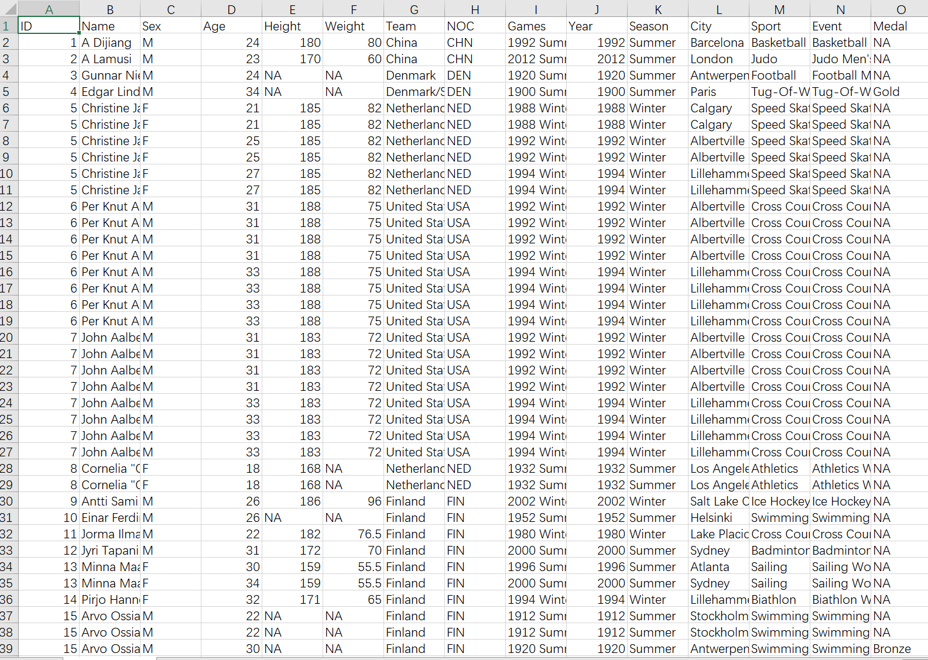

Slide 3
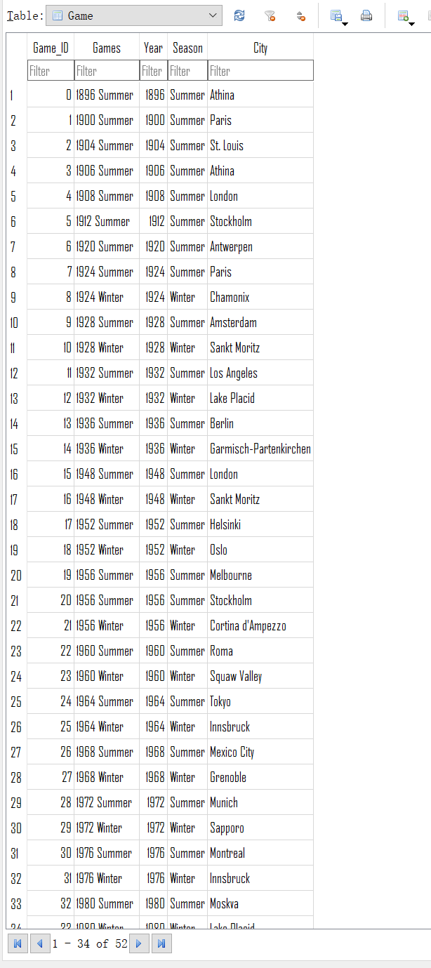
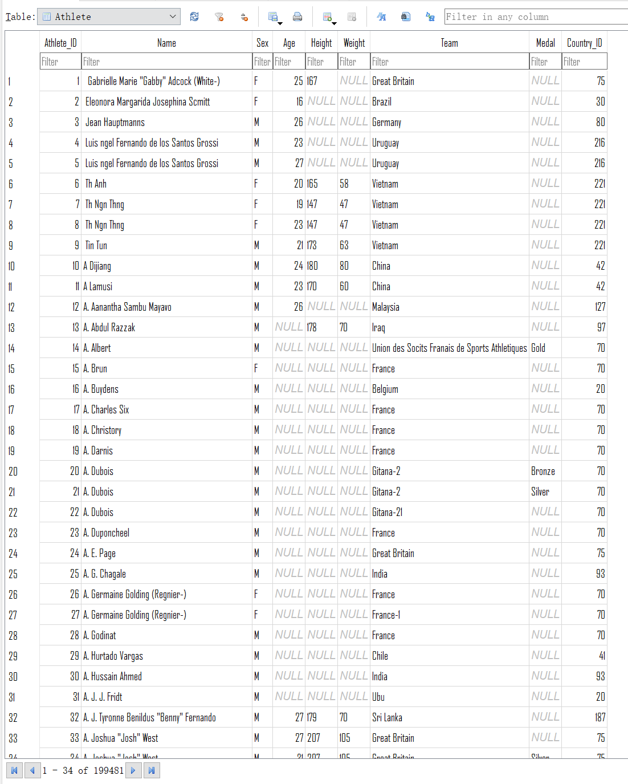
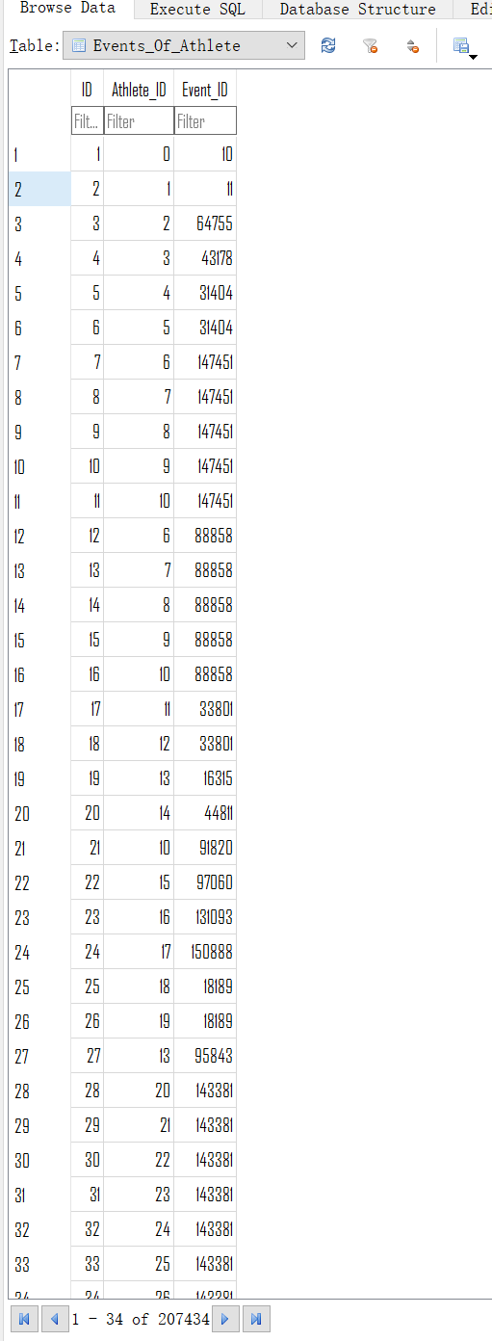

Slide 4
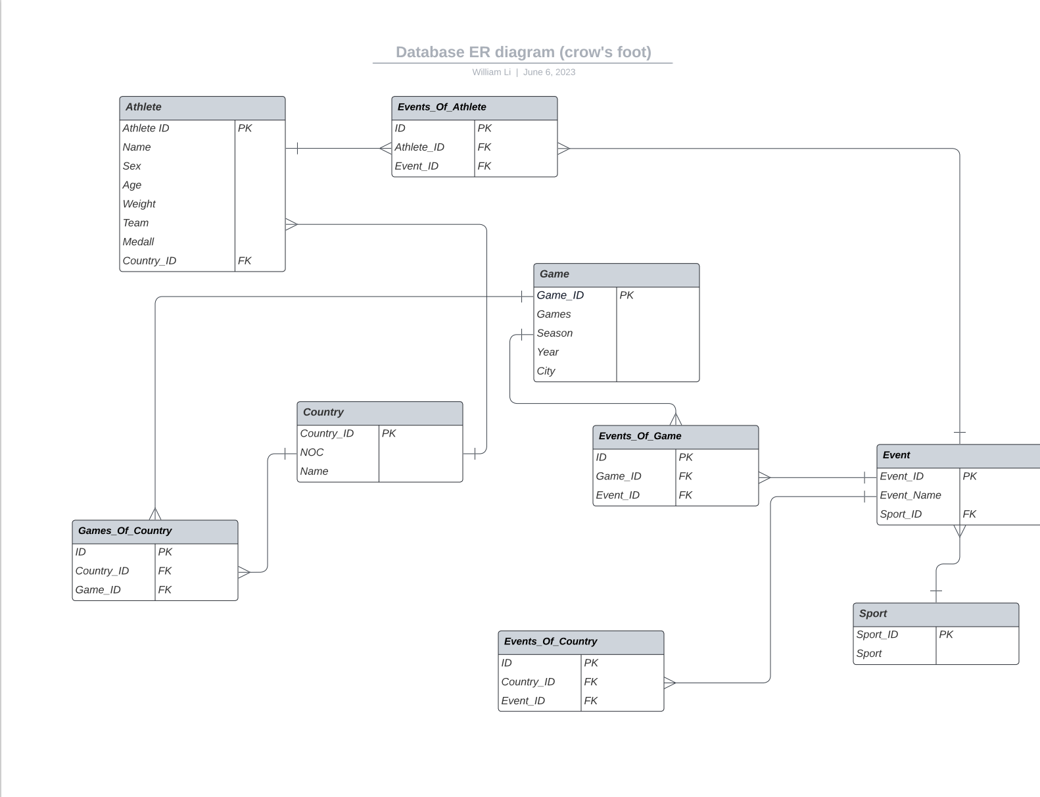
Schema, ERD
Notes:
To establish relationships between these tables, we have several foreign keys. The Participates relationship connects Athlete and Olympic Event tables, representing an athlete's participation in an event. The Part of relationship links the Olympic Event and Olympic Games tables, specifying which events are part of each Olympic edition. The Represents relationship connects the Olympic Games and Country tables, indicating which country participated in which games. Lastly, the Wins Medal relationship associates the Medal table with both the Athlete and Olympic Event tables, recording the medals won by athletes in specific events.

Slide 5
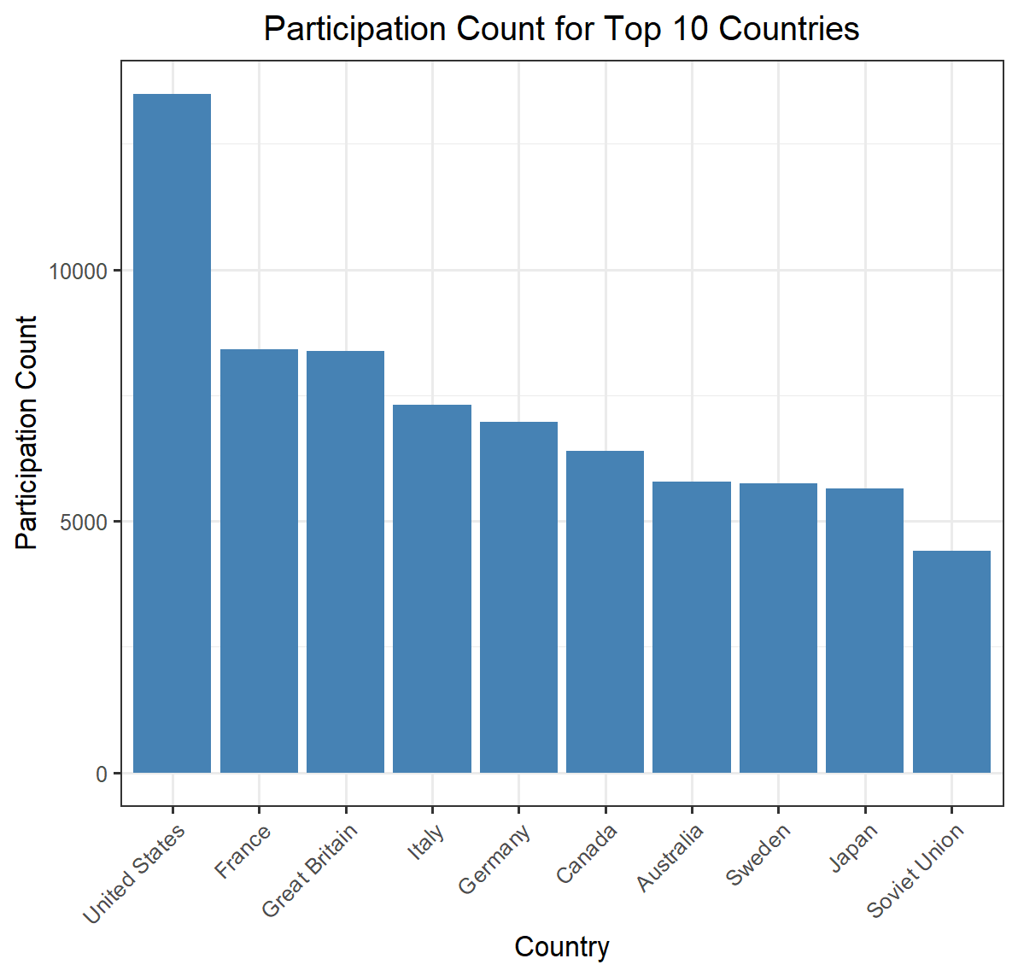
Top 10 countries with the highest number of participating athletes.
This query showcases the countries with the highest number of participating athletes, showing their strength and presence in the Olympic events.

Slide 6
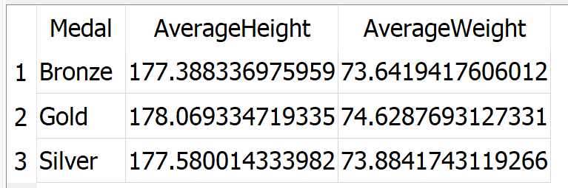
Average height and weight of medal-winning athletes
This query helps us understand whether there are any detectable differences in average height and weight between athletes who win gold, silver, or bronze medals. It provides insights into the physical attributes that might contribute to success in medal categories.

Slide 7
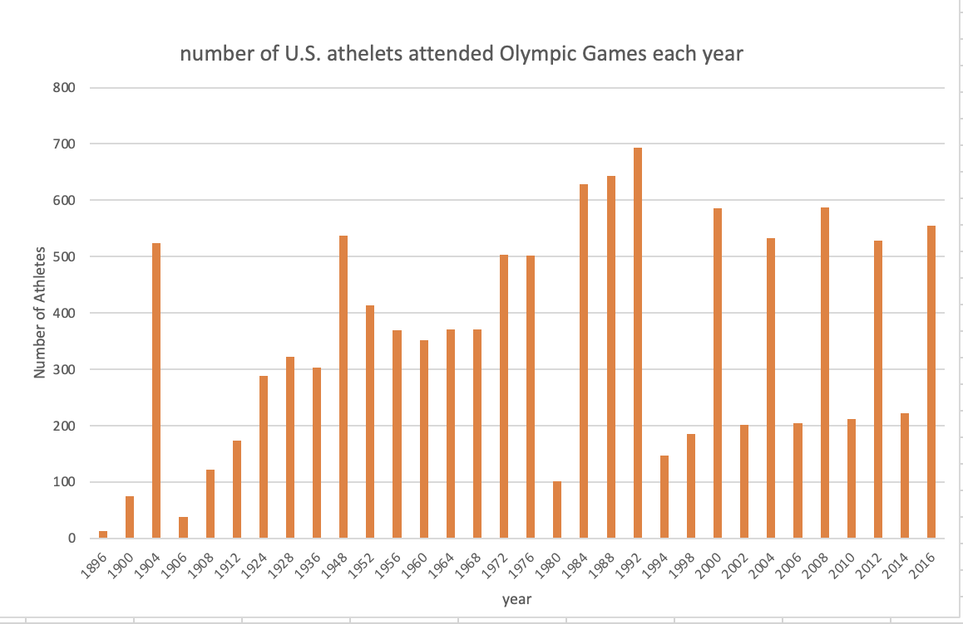
Number of athletes from the U.S. who participated in the Olympic Game
this query aims to show the number of U.S. Olympic participants over the years. This information helps analyze the country’s sporting culture, talent pool, and historical trends, contributing to a comprehensive understanding of the U.S.’s involvement in the Olympics.

Slide 8

Athlete who won the gold medals
Finding the athlete who won the gold medals is significant as it showcases exceptional achievement and dominance. It highlights the individual’s talent, determination, and dedication to inspire others and leaving a lasting legacy in the history of Olympics

Slide 9
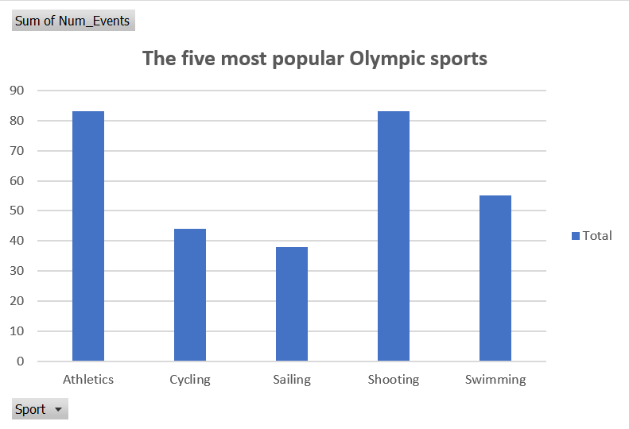
The five most popular Olympic sports in the history of Olympic Games
The goal of this query is to identify the five most popular Olympic sports. This entails tallying the number of events or players in each sport and rating them. This data is essential because it indicates which sports generate the most attention and participation during the Olympics, reflecting worldwide sports trends and preferences.

Slide 10
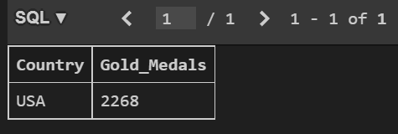
The country with the most gold medals
This query is to determine which country has won the most gold medals in Olympic Games history. This data is useful and meaningful because it can reveal which countries have had the most Olympic success, potentially indicating factors such as the strength of their sports programs, the level of investment in athlete development, and the country's overall sporting culture.

Slide 11
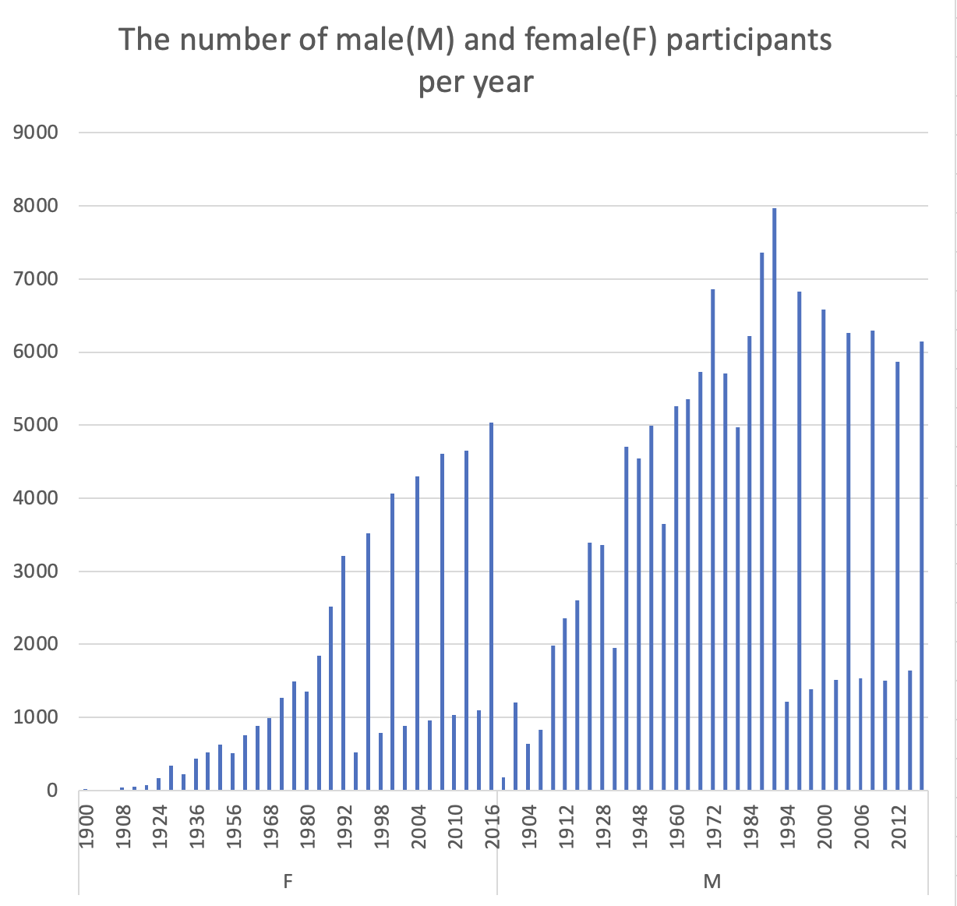
The number of male and female participants per year
This query retrieves the number of unique male and female athletes who participated in each year of the Olympic games. It directly shows a clear idea of the ratio of men to women participating in the Olympics. In this query, I choose to select column “Sex” and “Year”, and form them into a new table called “Athlete_Sex_Count”. After that, it clearly shows the number of male and female participants in different years.

Slide 12
All events that a specific athlete participated in
For this query, It gives us a clear picture of what sports the specific athlete has participated in. For the code of this query, I choose Per Knut Aaland from Norway as an example. This query is simple but really important in real life to count athletes’ performance. It can be used to extract the participation and award information of the specific athlete, which greatly improves the efficiency of the statistician. Also, it would be more convenient to check if the athlete participates in one specific sport event.

